Slide 1
Prediction of Cardiovascular Disease
Here is where your presentation begins

Slide 2
Cardiovascular Disease
Cardiovascular Diseases are a group of disorders of the heart and blood vessels which causes numerous problems , many of which are related to a process called atherosclerosis.
Atherosclerosis is a condition where the arteries build up fatty substances called plague or artheroma.
These can restrict the flow of oxygenated blood to vital organs which increases the risk of blood clots that could block the flow of blood to heart or brain.
Atherosclerosis is a kind of slow poison , generally we wont be aware of it but eventually causes heart attack or stoke and leads to death.
If this situation gets worse it leads to cardiovascular diseases. And they will be
Coronary Heart Disease
Heart Attack
Stroke
Angina
Hypertrophic cardiomyopathy
Pulmonary stenosis
And many more heart diseases

Slide 3
Major Risk Factors and also our variables
Ap_ hi
Ap_lo
Smoking
Cholesterol
Glucose
Systolic blood pressure
Above 150
Diastolic blood pressure
Below 60
Whether a person smokes or not
0-no
1-yes
Alcoholic
1.normal( Below 42 mmol/mol (6.0%)
2.above normal(Prediabetes: 42 to 47 mmol/mol (6.0 to 6.4%)
3.well above normal(Diabetes: 48 mmol/mol (6.5% or over)) well above normal(Diabetes: 48 mmol/mol (6.5% or over)
1.normal(less than 100 mg/deciliter)
2.above normal(100-160 mg/deciliter)
3. well above normal(160 and above)
Whether a person is
alocoholic or not
1-yes
0-no

Slide 4
Other Variables
Physical Activity
Age
Gender
Height
Weight
Whether a person does physical activity or not (1-yes,0-no)
Age Of the person
0-Women
1-men
Bmi
Height of the person
Weight of the person
Body Mass index obtained from
Height and weight

Slide 5
Objective
Using these variables we intend to find whether a person is having cardiovascular disease or not.
For this we use different models and find the correct
model that fits the data with good recall score.

Slide 6
Methodology
Data Cleaning and EDA
Checking Duplication and
Missed Values
Visualization
Univariate and Bivariate Analysis
Detecting Outliers
Feature Engineering
Model Selection
Training and Test Sets
Scaling
Model Comparison
Logistic Regression
Decision Tree Classifier with GridSearchCV
Random Forest with GridSearchCV

Slide 7
Data cleaning and EDA
→Basic EDA
Removing Duplicate Data
Removing columns with all unique values and having standard deviation=0
Statistical summary
Univariate analysis-Graphs
Bivariate analysis
→Feature Engineering
Gender and BMI
→Outlier treatment
3 IQR
→Multivariate Analysis
Pair-plot
Splitting the data
Scaling

Slide 8
Results
Descriptive Statistics
 | Age | Height | Weight | Ap_hi | Ap_lo | BMI
count | 66848 | 66848 | 66848 | 66848 | 66848 | 66848
mean | 53.381 | 164.423 | 74.181 | 126.804 | 81.318 | 27.527
std | 6.72 | 8.16 | 14.20 | 15.43 | 8.51 | 6.02
min | 30 | 55 | 11 | 100 | 60 | 3.47
25% | 48 | 159 | 65 | 120 | 80 | 23.88
50% | 54 | 165 | 72 | 120 | 80 | 26.37
75% | 58 | 170 | 82 | 140 | 90 | 30.12
Descriptive statistics is the first step in any analysis to understand the data.

Slide 9
Model Building
Models | Recall score | Accuracy | Roc Auc score
Logistic Regression | 0.67 | 0.73 | 0.72
Decision tree Pre Pruning | 0.61 0.67 | 0.62 0.71 | 0.62 0.71
Random Forest Pre Pruning | 0.70 0.68 | 0.71 0.72 | 0.70 0.72

Slide 10
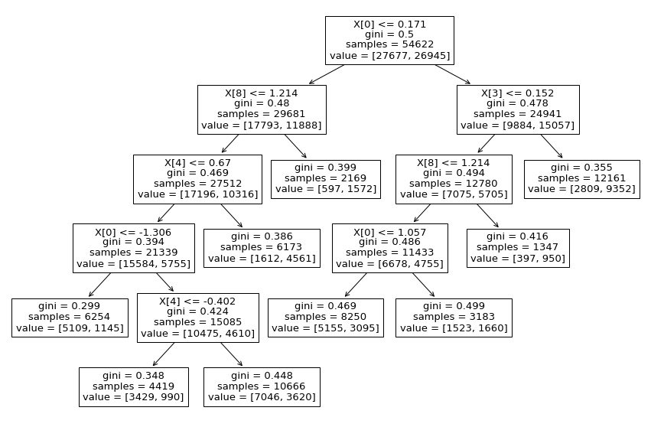
Decision tree after pruning

Slide 11
Thank You

